Slide 1

Dr. Mona Mohamed Arafa

Slide 2




Team members
Mariam Shehata
Lujain Mohamed
202002670
Bahaa Shamoon
202001572
Mahmoud Amgad
202001143
Mohamed Assem
202001886

Slide 3

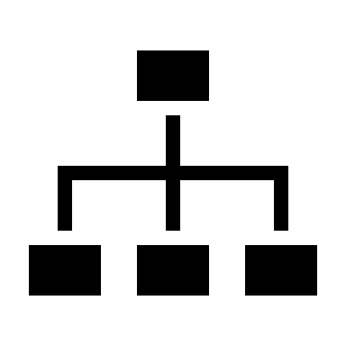

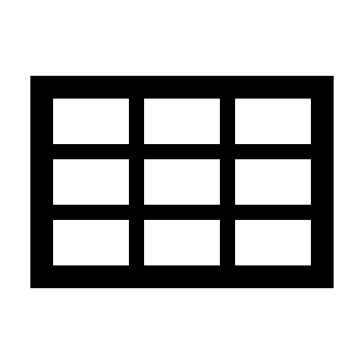

Agenda
Project idea
Objective
Normalization
Demo from GUI
ERD and Schema

Slide 4
Project Idea
Hospital management system enables hospitals to be able to manage the data and information to ensure the efficient and successful completion of operations and processes.
Generally, the hospital system helps to provide a better patient experience, to provide a several functions and to manage every department of the hospital.
-

Slide 5
Objective
Helping to improve the quality and to manage the data of every aspect. Also, we will create a hospital system that will have a friendly user interface to make sure that anyone can use it and make every process easily. Also, this system will record information related to diagnosis given to patients and keep information about different diseases that helps the doctor to treat the patients.
The main components of our system are the hospital itself, doctors, patients, rooms, treatment, time, etc. Every component has a unique ID and details about every function and relation in the system that are shown in the ERD diagram. We will apply everything we have taken to create an efficient system using database processes.
-

Slide 6
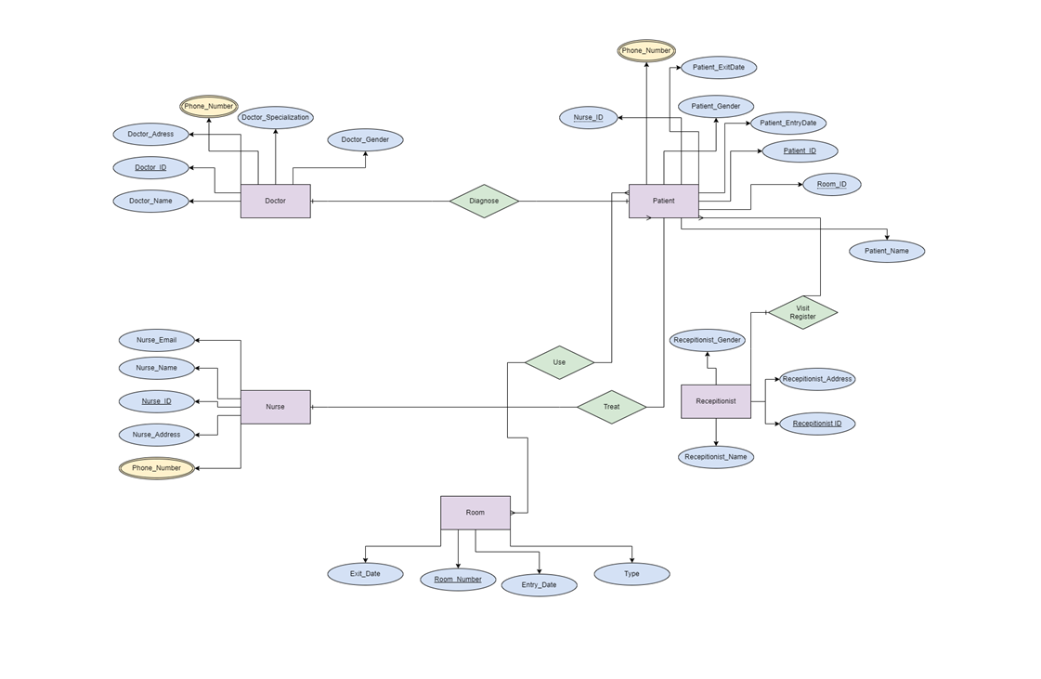
ERD and Schema
-

Slide 7
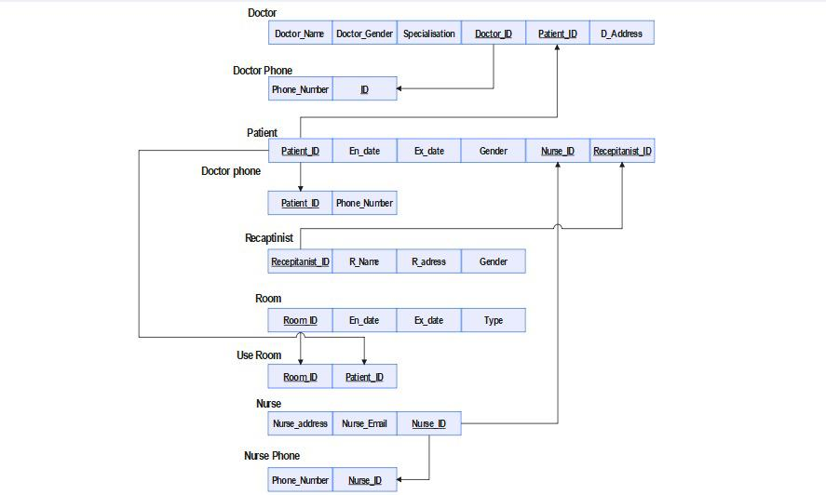
ERD and Schema cont.
-

Slide 8
Normalization
In all tables:
a. First Normal Form (1NF) →There are no repeating group, so these tables are in (1NF).
b. Second Normal Form (2NF)→ There are no partial dependency as the tables have no composite primary key, so these tables are in (2NF).
c. Third Normal Form (3NF)→ There are no transitive dependency, so these tables are in (3NF).
-

Slide 9
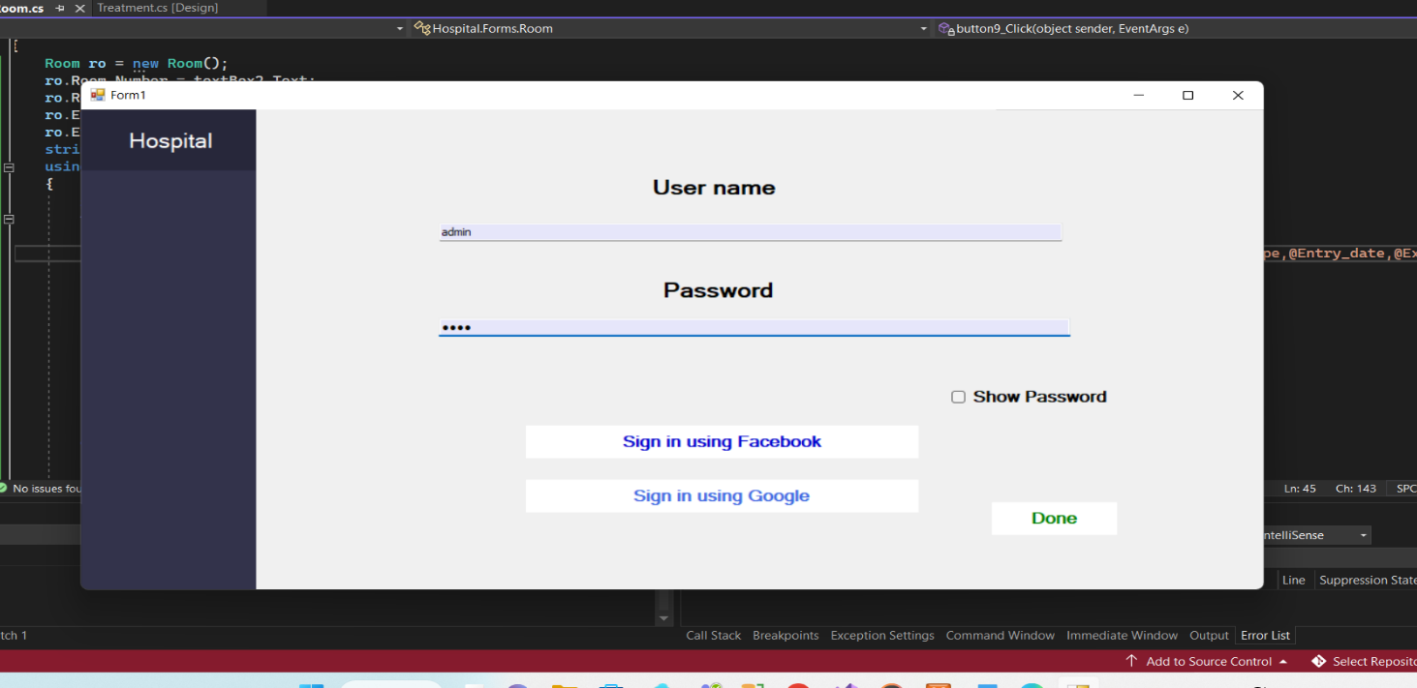
Demo
-

Slide 10
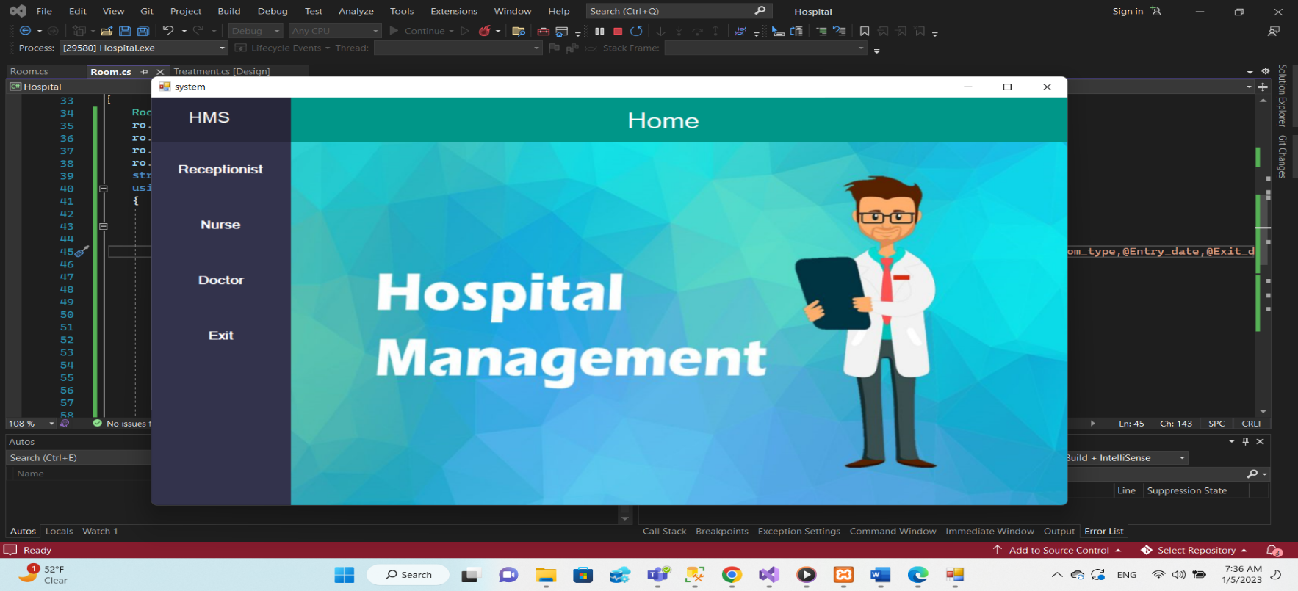
Demo
-

Slide 11
Demo
-

Slide 12
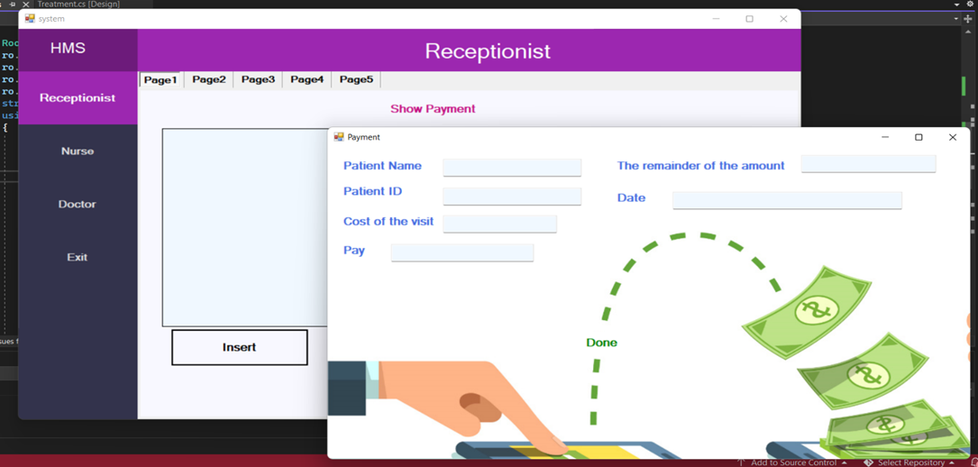
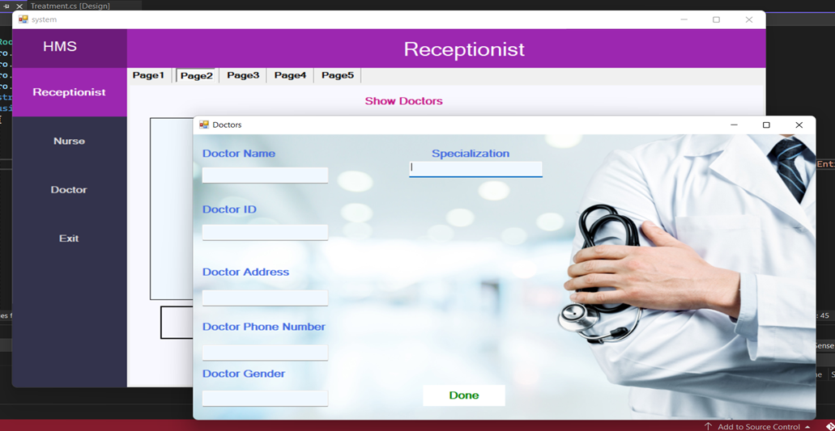
-

Slide 13
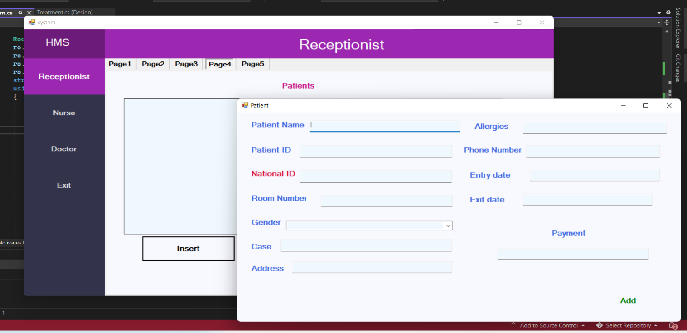
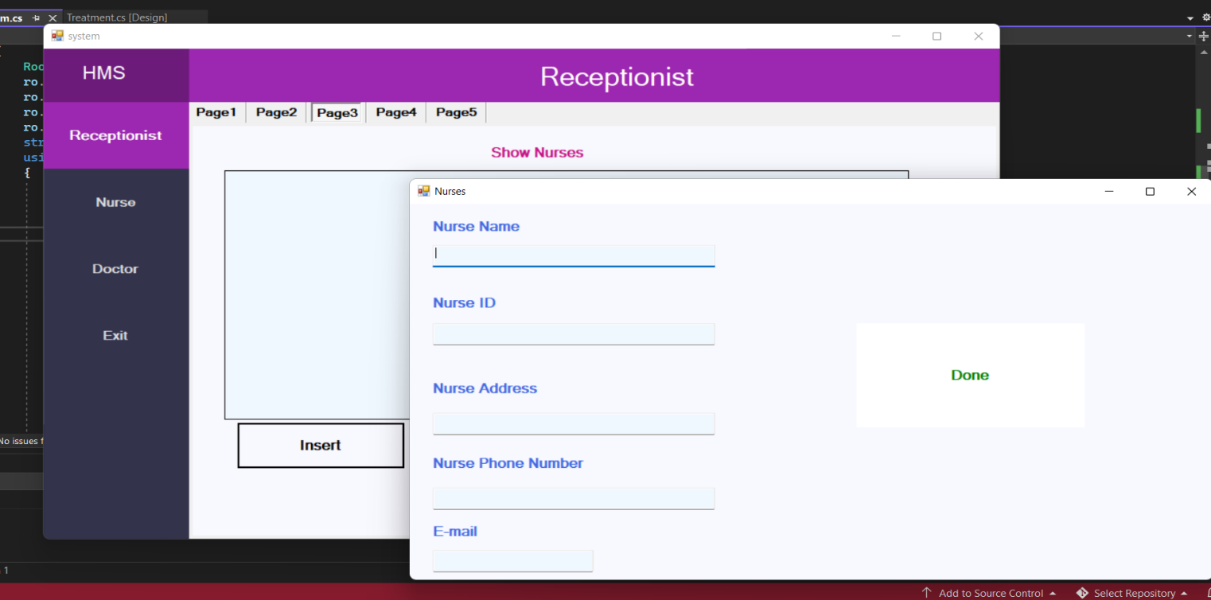
-

Slide 14
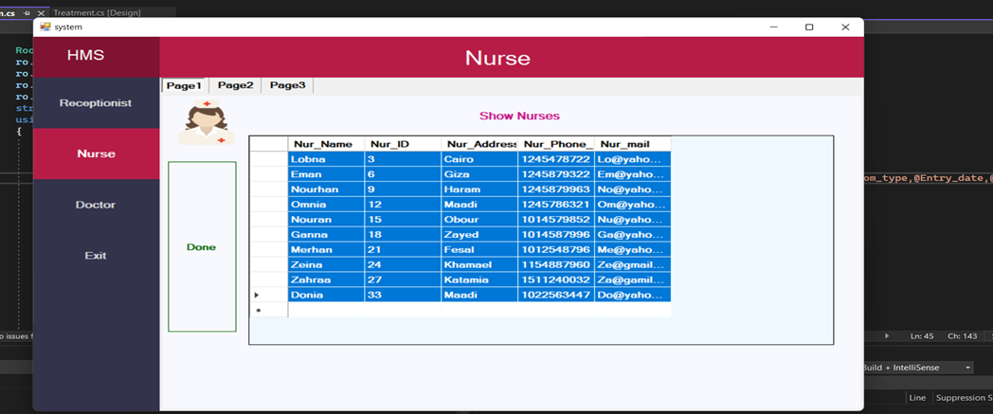
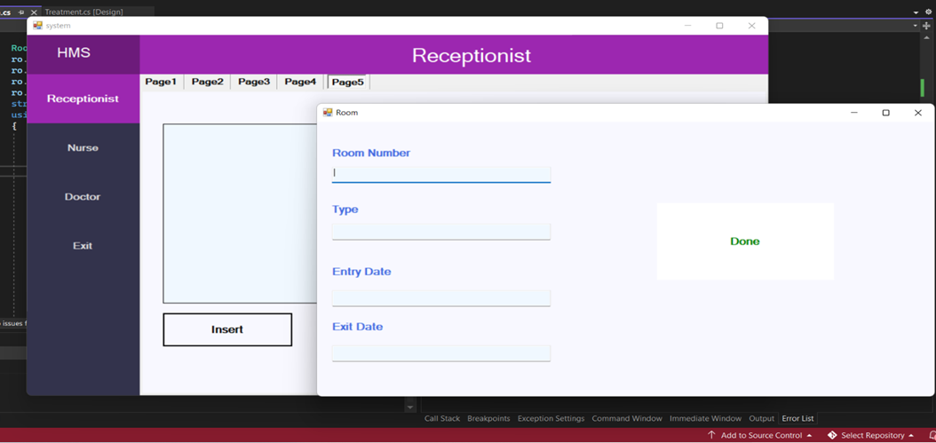
-

Slide 15
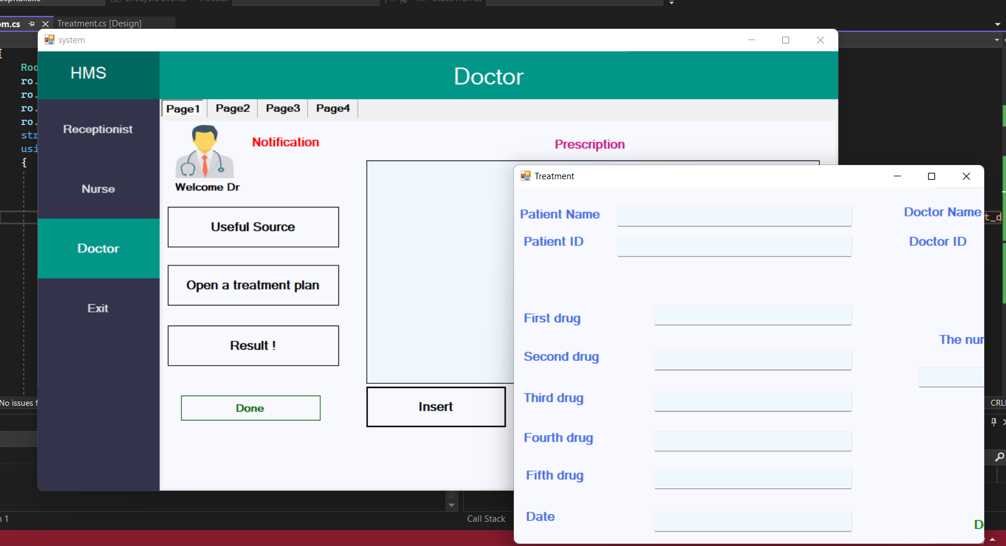
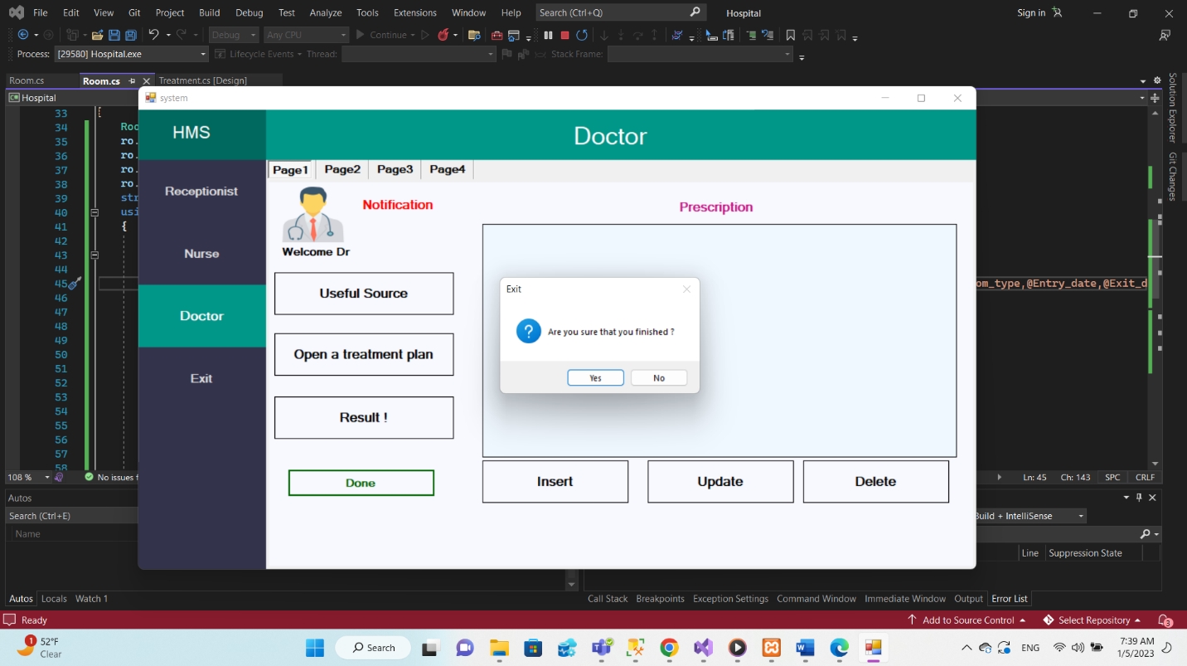
-

Slide 16
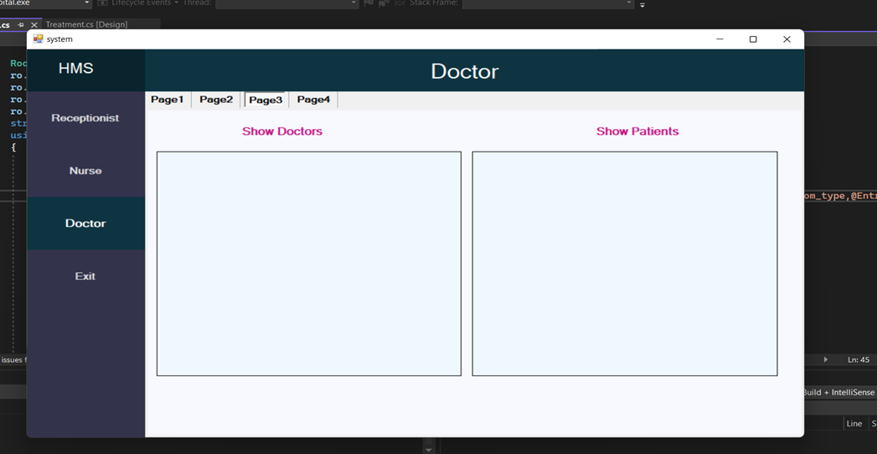
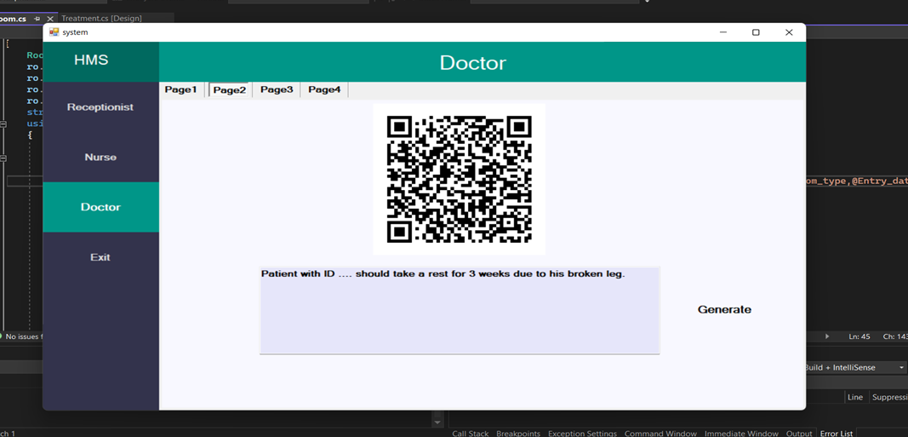
-

Slide 17

-

